Slide 1
The New Nation
Part II
The Jeffersonian Era:
Jefferson-War of 1812

Slide 2
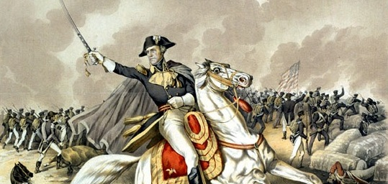
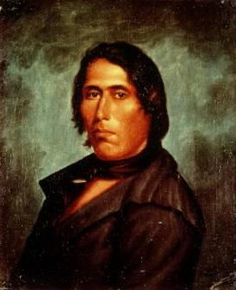

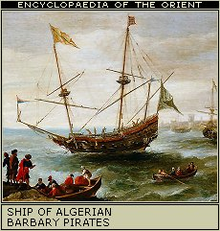
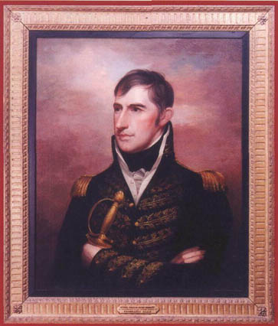
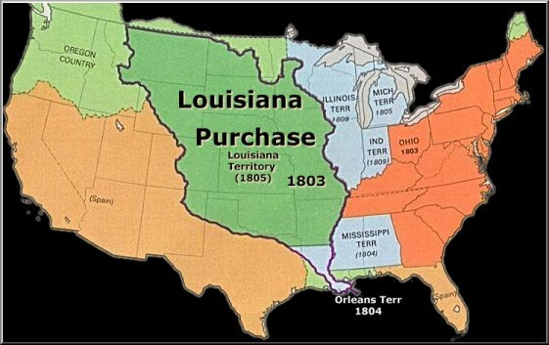
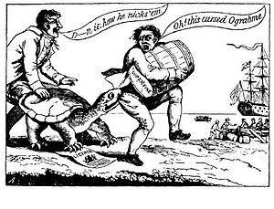
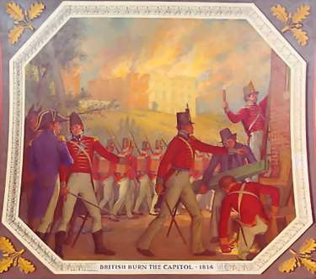
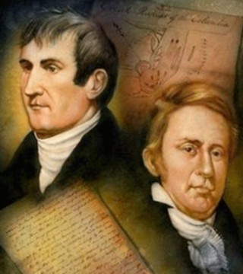
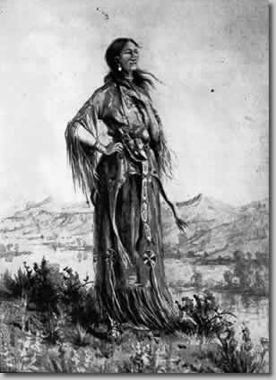
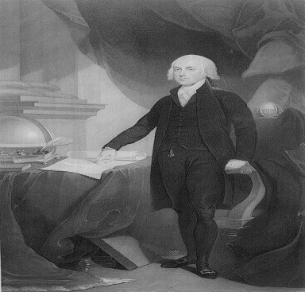
Main Objectives:
Describe major political, social, & economic events of Thomas Jefferson’s presidency: Louisiana Purchase, Reducing the Federal Government, Impressments of Seamen, Embargo Act of 1807
2. Analyze the major causes and effects of the War of 1812
James Madison
Jackson-Battle of New Orleans
Tecumseh
Harrison
British burn Washington
Madison
Lewis & Clark
Sacajawea
Embargo Act of 1807

Slide 3
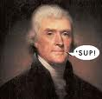
Jefferson Simplifies Government
Jefferson’s election ended the Federalist period
He was the first Democratic-Republican president
He was the first to serve in the District of Columbia
He made the president appear more like common Americans
because he did away with certain formalities
Decreased the size of the federal government:
  Cut government bureaucracy
  Reduced the size of the Army & Navy
  Reduce national debt by almost half despite eliminating some taxes
  Paid debt by selling western federal lands
  “That government which governs least, governs best” Thomas Paine
  Jefferson believed in this philosophy, too!

Slide 4
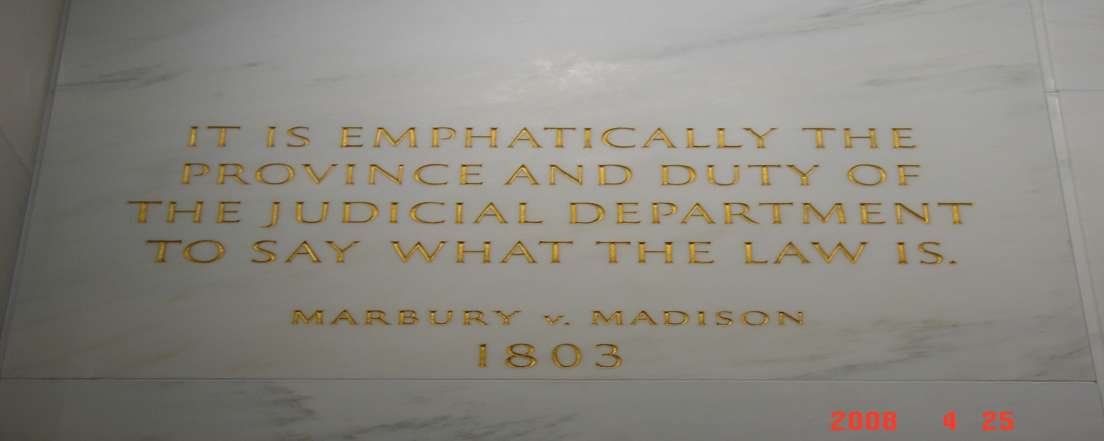
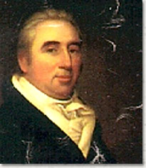
Marbury v Madison Recap
Before leaving office, John Adams had the Judiciary Act of 1801 passed that would create 16 new federal judgeships in an attempt to keep Federalist in control of one branch of the federal government (midnight appointments)
William Marbury did not receive his appointment and sued for his position
The Supreme Court (Chief Justice John Marshall) ruled against Marbury in the 1803 case Marbury v. Madison which established judicial review – the ability of the Supreme Court to rule and act of Congress unconstitutional.
4. William Marbury did not get to become a judge ☹
Marbury

Slide 5
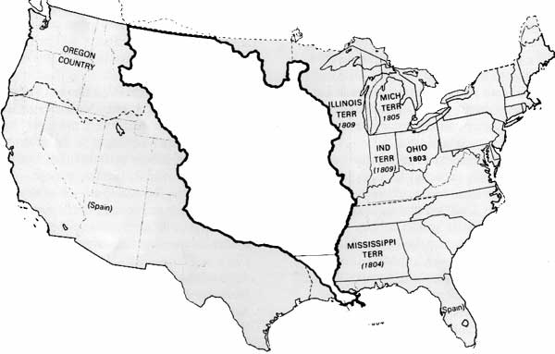
Louisiana Territory
Ceded by Spain to France in 1800
Voided Treaty of San Lorenzo (Pinckney Treaty)
  Gave US transit rights to Mississippi River
  Gave US right of deposit in New Orleans
Threatened hold on lands west of Appalachians
  Farmers might not get crops to market
Feared Napoleon building an American Empire
  Which was his plan!

Slide 6
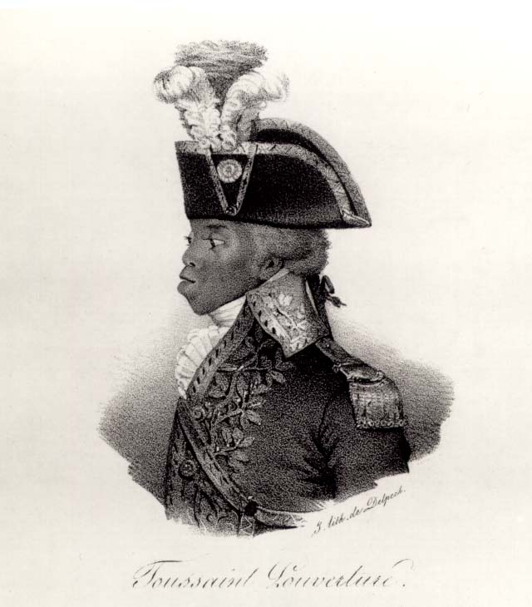
Toussaint L’Ouverture
A.K.A. the “Black Napoleon”
Led a slave revolt on the island of Hispaniola
  Saint Dominique (Santo Domingo)
Finally crushed after Napoleon sent 20,000 troops
  Which finally crushed the revolt
  But suffered a heavy toll because of yellow fever
Ended Napoleon’s dream of a North American Empire

Slide 7
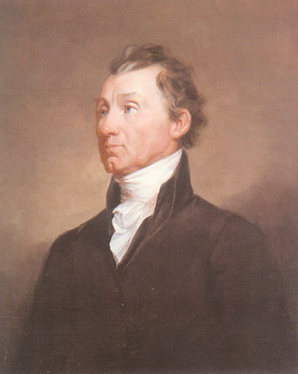
Negotiations
Robert R. Livingston
  US Minister to France
James Monroe
  Sent to France specifically to negotiate deal
  Authorized to purchase New Orleans and West Florida
    For up to $10 million
Talleyrand
  French foreign minister
  Offered all of Louisiana for $15 million in 1803
    60 million francs
    About 3¢ per arce
    Agreed to by Livingston and Monroe
      Before Napoleon changed his mind
      But without the consent of Jefferson

Slide 8
Jefferson’s Dilemma
He was a strict constructionist
  No power to add new territory
  No power to grant citizenship to residents of territory
  So concluded the purchase was unconstitutional
He submitted the treaty to the Senate anyway
  Which easily ratified it by the required 2/3 vote
  Opposed by the Federalists
    Who ironically has always been loose constructionists
    Because the west had been voting republican
      More western states, more Republicans, less control for Federalists
      Saw the Louisiana Purchase as their death warrant

Slide 9
Lewis and Clark
Sent to explore the Louisiana Purchase (1804-06)
Meriweather Lewis
  Jefferson’s personal secretary
William Clark
  Professional soldier
  Had participated in Battle of Fallen Timbers
Departed from St. Louis during winter of 1804
Assisted by Sacajawea
  Shoshone guide and translator
Followed course of Missouri River
Went as far as the mouth of Columbia River
  Giving the US claims to the Oregon Country

Slide 10
Jefferson Maintains Neutrality
Due to the conflict between Britain & France, American shipping rights were being violated
Both France & Britain seized cargos from American ships, but the British impressed American sailors (kidnapped them & forced them into service in the British navy) leading some Americans to call for war
Jefferson wanted to avoid war if at all possible
Chesapeake Incident: (1807)British navy fired upon an American ship and boarded it searching for British deserters, killing 3 Americans
Embargo Act of 1807: In response to the Chesapeake incident & as an attempt to avoid war, Jefferson convinced Congress to stop all foreign trade & keep American ships docked in the US with the embargo (Hoped stopping US trade would damage Britain & France’s economies & force them to stop seizing American ships
  Embargo hurt American economy more than Britain or France and was lifted by Jefferson before leaving office in 1809

Slide 11
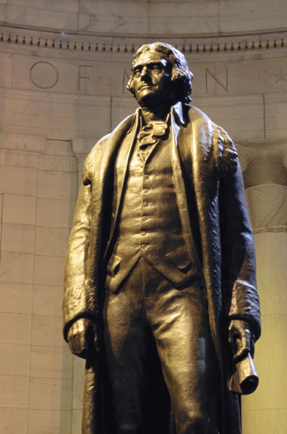

Jefferson Leaves office in 1809
Jefferson followed the two term tradition of Washington
and did not seek a third term as president.
He returned home to his beloved Monticello in Virginia
and founded the University of Virginia because he
believed education was key to sustaining government

